Slide 1
Augmented Reality Using Computer Vision
Presented By:
Venna Meenakshi Reddy(192471048)
K.Varshini(192472358)
S.Amulya(192321044)
Amrita Anaikumar(192471035)
Sreenithi Ramesh Kumar (192412112)

Slide 2
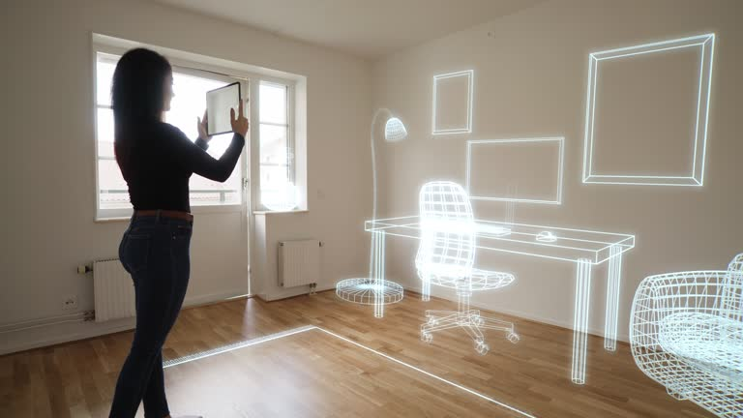
What is Augmented Reality (AR)?
Augmented Reality is a technology that adds digital content to the real-world environment.
It uses a camera and sensors to understand the surrounding environment.
Virtual objects, text, images, or information are displayed over the real-world view.
Example: AR furniture apps, Snapchat filters, Google Maps Live View, AR games.
What is Computer Vision?
Computer Vision is a field of AI that enables computers to understand and interpret images and videos.
It can detect objects, features, corners, movements, and patterns in a scene.
In AR, computer vision helps the system understand the real environment and determine where and how virtual content should be placed.

Slide 3
(a) Image Preprocessing & Feature Detection
Image Preprocessing and Feature Detection in AR
Computer vision first captures the real-world scene using a camera.
Image preprocessing improves the quality of the captured image.
Common preprocessing techniques:
  Grayscale conversion
  Noise removal
  Image resizing
  Contrast enhancement
Feature detection identifies important visual patterns in the environment.
Features help the AR system understand where virtual content should be placed.
Example:
An AR furniture application detects the floor, walls, and important points before placing a virtual sofa.

Slide 4
Corner Detection for Identifying Important Points
Corners are points where image intensity changes significantly in different directions.
They are useful because they are usually stable and easy to recognize.
Common corner detection methods:
  Harris Corner Detection
  Shi-Tomasi Corner Detection
Detected corners can be used as reference points for AR tracking.
OpenCV provides functions for detecting and processing these points.
Flow:
Camera Image → Preprocessing → Corner Detection → Important Points → AR Reference

Slide 5
(b) Scale-Invariant Feature Matching
Scale-Invariant Feature Detection
Recognizing Objects at Different Scales
An AR system may observe the same object from different distances.
The object's size in the image can change significantly.
Scale-invariant features help recognize the same object despite size changes.
Important techniques include:
  SIFT
  SURF
  ORB
These techniques extract distinctive features from an image.
Example:
A phone-based AR application can recognize a poster whether the user is standing close to it or far away.

Slide 6
Feature Matching
Matching the Same Object Under Different Conditions
Feature descriptors represent the detected points.
The descriptors from the current camera frame are compared with stored/reference features.
It can handle changes in:
  Scale
  Rotation
  Viewing angle
  Moderate lighting changes
Process:
Reference Image → Feature Extraction → Descriptor → Feature Matching → Object/Location Recognized

Slide 7
c) Object Recognition and Tracking
Object Recognition
Recognizing Real-World Objects
Object recognition identifies objects present in the camera view.
Computer vision extracts visual features from the image.
The system compares these features with trained/reference objects.
Modern AR systems can use:
  Feature-based recognition
  Machine learning
  Deep learning
  Object detection models
Recognition tells the AR application what object is present and where it is located.
Example:
An AR educational application recognizes a book and displays additional information above it.

Slide 8
Object Tracking
Continuously Following Objects
Recognition identifies an object initially.
Tracking continuously follows the object across video frames.
The system detects how the object's position changes.
Tracking prevents virtual objects from disappearing when the camera moves.
Common tracking approaches:
  Optical flow
  Feature tracking
  Object trackers
  Marker tracking
Flow:
Frame 1 → Detect Object → Frame 2 → Track Movement → Frame 3 → Update Position

Slide 9
(d) Motion Estimation and Camera Pose
Motion Estimation
Estimating Camera Movement
AR needs to understand how the camera moves through the environment.
Motion estimation calculates the change between consecutive frames.
It uses visual features to determine:
  Camera movement
  Direction of movement
  Relative displacement
Feature points are compared between frames to estimate motion.
Example:
When the user moves the phone to the right, the AR system detects this movement and updates the virtual object's position.

Slide 10
Camera Pose Analysis
Determining Camera Position and Orientation
Camera pose describes:
Position — where the camera is located.
Orientation — the direction in which the camera is looking.
Computer vision estimates camera pose using:
Feature points
Corresponding points between images
Camera calibration
Geometric transformations
Camera Pose → Position + Rotation
AR Benefit:
Correct camera-pose estimation keeps virtual objects aligned with the real environment even when the user moves around.

Slide 11
(e) Real-Time OpenCV Processing
Real-Time AR Processing Using OpenCV
OpenCV provides tools for processing camera frames in real time.
A continuous video stream is captured from the camera.
Each frame is processed to detect features, objects, and movement.
OpenCV can perform:
  Image preprocessing
  Feature detection
  Feature matching
  Object tracking
  Motion estimation
Real-Time Pipeline:
Camera → Frame Capture → Preprocessing → Feature Detection → Tracking → Pose Estimation → Virtual Overlay

Slide 12
Placing and Maintaining Virtual Objects
Accurate Virtual Object Placement
The AR system combines information from all computer vision stages.
Camera pose determines where the virtual object should appear.
Tracking continuously updates its position.
Perspective transformations make the virtual object appear correctly aligned.
As the camera moves, the virtual content remains attached to the real-world location.
Real-Time AR System
Real World → Camera → OpenCV Processing → Environment Understanding → Camera Pose → Virtual Object Placement → Continuous Tracking
Example:
In an AR interior-design application, a virtual chair can be placed on the floor and remain in the same position while the user moves the camera around it.

